Slide 1

SMART WATCH
SUBMITTED BY:
AISIRI H R – 1RV17EI004
RUTHVIK SJ – 1RV17EI044
SRINIVAS PRABHU – 1RV17EI056
VINAY BALAMURALI – 1RV17EI063

Slide 2
ABSTRACT
In recent technological innovations in the field of disease prevention and maintenance of patient health have enabled the evolution of fields such as monitoring systems. Heart rate is a very vital health parameter that is directly related to the soundness of the human cardiovascular system.
It can be measured either by the ECG waveform or by sensing the pulse - the rhythmic expansion and contraction of an artery as blood is forced through it by the regular contractions of the heart. The pulse can be felt from those areas where the artery is close to the skin.
In this project we have built a smart watch which can monitor and keep track of the heart beat of the user. The pulse is sensed by the artery lying underneath and is displayed on OLED interfaced with it whenever touched.

Slide 3
HEART RATE AND HEART RATE MONITORING
Heart rate (HR) or pulse rate represents the number of times a heart beats each minute. The determination of what a normal heart rate is depends on many factors, such as age, body size, movement, exercise, and heart conditions. A normal heart rate can be between 70 and 100 beats per minute (bpm).
A heartrate monitor is a personal monitoring device that allows one to measure/display heart rate in real time or record the heart rate for later study. It is largely used to gather heart rate data while performing various types of physical exercise.

Slide 4
VARIOUS METHODS TO MONITOR
HOLTER MONITOR
EVENT RECORDER
MOBILE CARDIAC TELEMETRY (MCT)
INSERTABLE CARDIAC MONITOR (ICM)

Slide 5
APPLICATIONS
Healthcare applications
Monitoring health of the elderly
Monitoring Exercise Intensity
Preventing Overtraining
Estimation of Maximal oxygen uptake (VOmax) and EE (Energy-Expenditure)

Slide 6
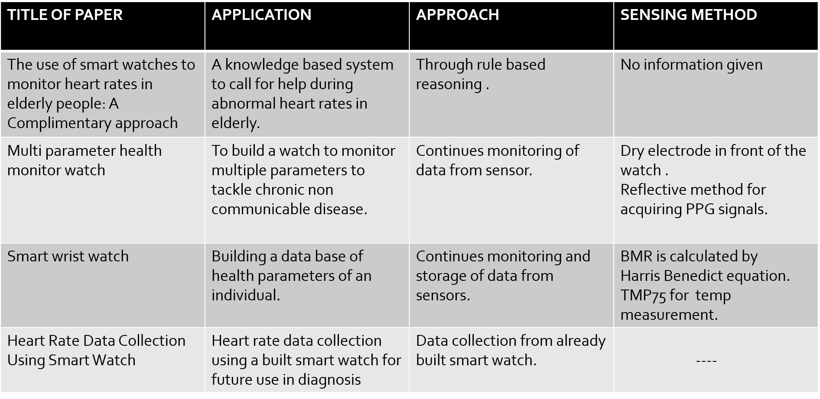
LITERATURE SURVEY

Slide 7
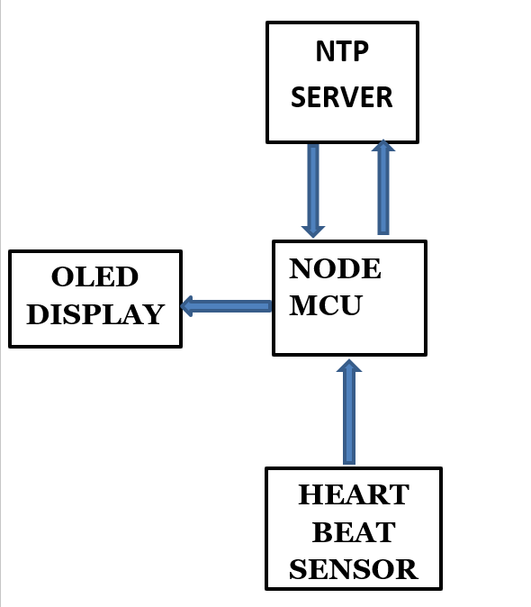
BLOCK DIAGRAM
NodeMCU
TOUCH SENSOR

Slide 8
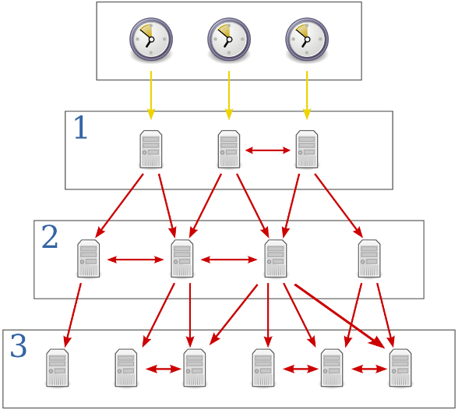
NTP stands for Network Time Protocol, and it is an Internet protocol used to synchronize the clocks of computers to sometime reference. NTP uses a hierarchical, semi-layered system of time sources. Each level of this hierarchy is termed a stratum and is assigned a number starting with zero for the reference clock at the top.
NTP SERVER

Slide 9
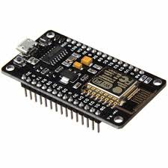
NODE MCU
NodeMCU is an open source Lua based firmware for the ESP8266 WiFi SOC from Espressif and uses an on-module flash based SPIFFS file system.
It supports I2C, SPI,UART protocols.
It comprises of 10 GPIO pins, i.e. 9 Digital pins and one Analog pin (with a built-in ADC).
Memory : 128kBytes
Storage : 4MBytes

Slide 10
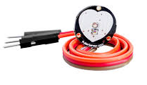
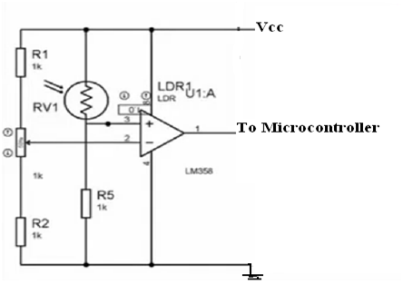
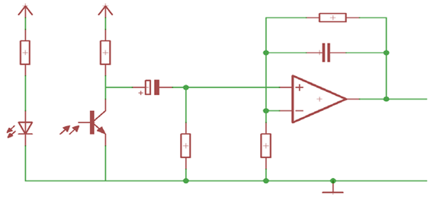
Heart Beat Sensor
The heartbeat sensor is based on the principle of photo phlethysmography.
It measures the change in volume of blood through any organ of the body which causes a change in the light intensity through that organ (a vascular region). The flow of blood volume is decided by the rate of heart pulses and since light is absorbed by blood, the signal pulses are equivalent to the heart beat pulses.
In case of applications where heart pulse rate is to be monitored, the timing of the pulses is more important.

Slide 11
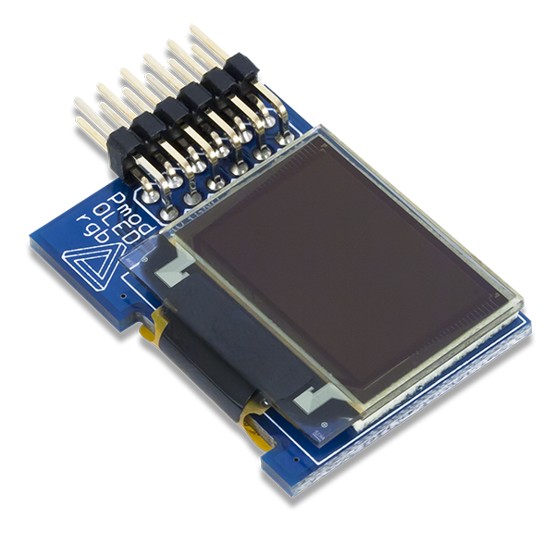
OLED
An organic light-emitting diode (OLED) is a light-emitting diode (LED) in which the emissive electroluminescent layer is a film of organic compound that emits light in response to an electric current.
This organic layer is situated between two electrodes; typically, at least one of these electrodes is transparent.
OLEDs are used to create digital displays in devices such as television screens, computer monitors, portable systems such as smartphones, handheld game consoles and PDAs.
The OLED we are using is SSD1306, with a resolution of 128 x 32.

Slide 12
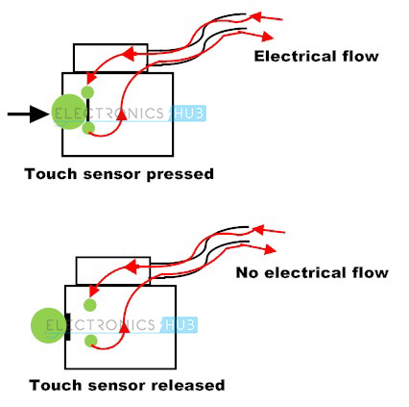
TOUCH SENSOR
A touch sensor detects touch or near proximity without relying on physical contact.
Touch sensors are also called as tactile sensors and are sensitive to touch, force or pressure. They are one of the simplest and useful sensors. The working of a touch sensor is similar to that of a simple switch. When there is contact with the surface of the touch sensor, the circuit is closed inside the sensor and there is a flow of current. When the contact is released, the circuit is opened and no current flows.

Slide 13
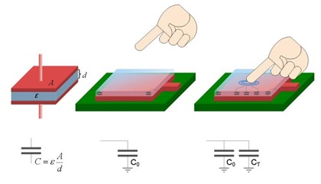
WORKING PRINCIPLE
The principle of a capacitive touch sensor is explained below.
The simplest form of capacitor can be made with two conductors separated by an insulator. Metal plates can be considered as conductors. The formula of capacitance is shown below.
C = ε₀ * ε_{r} * A / d
Where
ε₀ is the permittivity of free space
ε_{r} is relative permittivity or dielectric constant
A is area of the plates and d is the distance between them.
Capacitance is directly proportional to the area and inversely proportional to the distance.

Slide 14
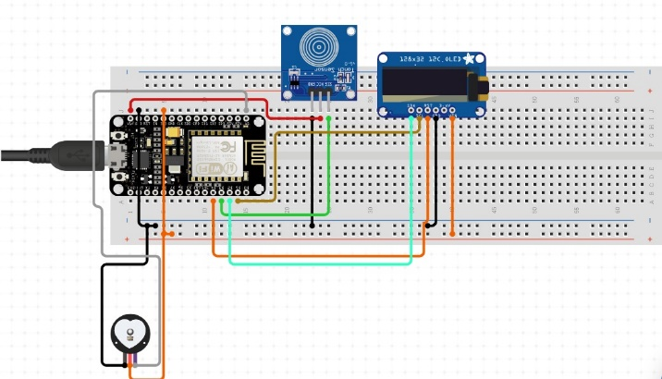
CIRCUIT DIAGRAM AND WORKING

Slide 15
VERILOG CODE
module timer(clk,rst,y);
input clk,rst;
reg a,b,c,d;
output reg [3:0] y;
reg [26:0] clkd;
always@(posedge clk) clkd=clkd+1;
always@(posedge clkd[20])
begin
case(a)
0: y[0]=8'b00000011;
1: y[0]=8'b10011111;
2: y[0]=8'b00100101;
3: y[0]=8'b00001101;
4: y[0]=8'b10011001;
5: y[0]=8'b01001001;
6: y[0]=8'b01000001;
7: y[0]=8'b00011111;
8: y[0]=8'b00000001;
9: y[0]=8'b00001001;
default: y[0]=8'b00000000;
endcase
if(b==0)
begin
a=a-1’d1;
b=9;
end
else b=9;

Slide 16
case(b)
0: y[1]=8'b00000010;
1: y[1]=8'b10011110;
2: y[1]=8'b00100100;
3: y[1]=8'b00001100;
4: y[1]=8'b10011000;
5: y[1]=8'b01001000;
6: y[1]=8'b01000000;
7: y[1]=8'b00011110;
8: y[1]=8'b00000000;
9: y[1]=8'b00001000;
default: y[1]=8'b00000000;
endcase
if(c==0&&d==0)
begin
if(b==0)
begin
a=a-1'd1;
b=9;
c=5;
d=9;
end
else
begin
b=b-1'd1;
c=5;
d=9;
end
end

Slide 17
case(c)
0: y[2]=8'b00000011;
1: y[2]=8'b10011111;
2: y[2]=8'b00100101;
3: y[2]=8'b00001101;
4: y[2]=8'b10011001;
5: y[2]=8'b01001001;
6: y[2]=8'b01000001;
7: y[2]=8'b00011111;
8: y[2]=8'b00000001;
9: y[2]=8'b00001001;
default: y[2]=8'b00000000;
endcase
if(d==0)
begin
c=c-1'd1;
d=9;
end
case(d)
0: y[3]=8'b00000011;
1: y[3]=8'b10011111;
2: y[3]=8'b00100101;
3: y[3]=8'b00001101;
4: y[3]=8'b10011001;
5: y[3]=8'b01001001;
6: y[3]=8'b01000001;
7: y[3]=8'b00011111;
8: y[3]=8'b00000001;
9: y[3]=8'b00001001;
default: y[3]=8'b00000000;
endcase
d=d-1'd1;
end
endmodule

Slide 18
REFERENCE
[1] Majid H. Alsulami, Anthony S. Atkins, Russell J Campion , The Use of Smart Watches to Monitor Heart Rates in Elderly People: A Complementary Approach.
[2] Lipeng Fang Xianxiang Chen , Zhen Fang, Kai Tong , Jiankang Liu Zhengling He, Junxia LiMulti, “parameter health monitoring watch”. 2017 IEEE 19th International Conference on e-Health Networking, Applications and Services
[3] Najuka Jagtap, Jagannath Wadgaonkar, Kalyani Bhole , Smart Wrist Watch, 2016 IEEE Students’ Conference on Electrical, Electronics and Computer Science
[4] H. Mansor, M. H. A. Shukor, S. S. Meskam, N. Q. A. M. Rusli, and N. S. Zamery, “Body temperature measurement for remote health monitoring system,” in Smart Instrumentation, Measurement and Applications (ICSIMA), 2013 IEEE International Conference on, pp. 1–5, IEEE, 2013.

